Slide 1
Human Resource Analytics
Gurunatha Hebbar​

Slide 2
AGENDA
Introduction​
Basic Insights
​Data Visualization
Areas of Focus
​Summary​

Slide 3
Introduction
Designing a Power BI dashboard to understand AtliQ Technologies which is a Software and Data Solution Company’s Employee Presence Data.
The final dashboard was effective at displaying the Employee Presence, Employees Work From Home %(WFH), Employee Sick Leave % (SL) of AtliQ Technologies.
Although the Employee Names are Randomized but the Data used here is taken from Real life Dataset.
This dashboard could help in Analyzing the Human Resources and taking correct decisions.

Slide 4
Basic Insights
Understanding the requirements

Slide 5
Insights
Working Preference of People :
Understand the working preference between Work From Home and Work From Office and what could be the reason behind these.
Sick Leave % :
Finding out the percentage of the employees who are taking sick leaves and finding out the reasons behind the same.

Slide 6
Data Visualization
Creating a data visualization through PowerBI

Slide 7
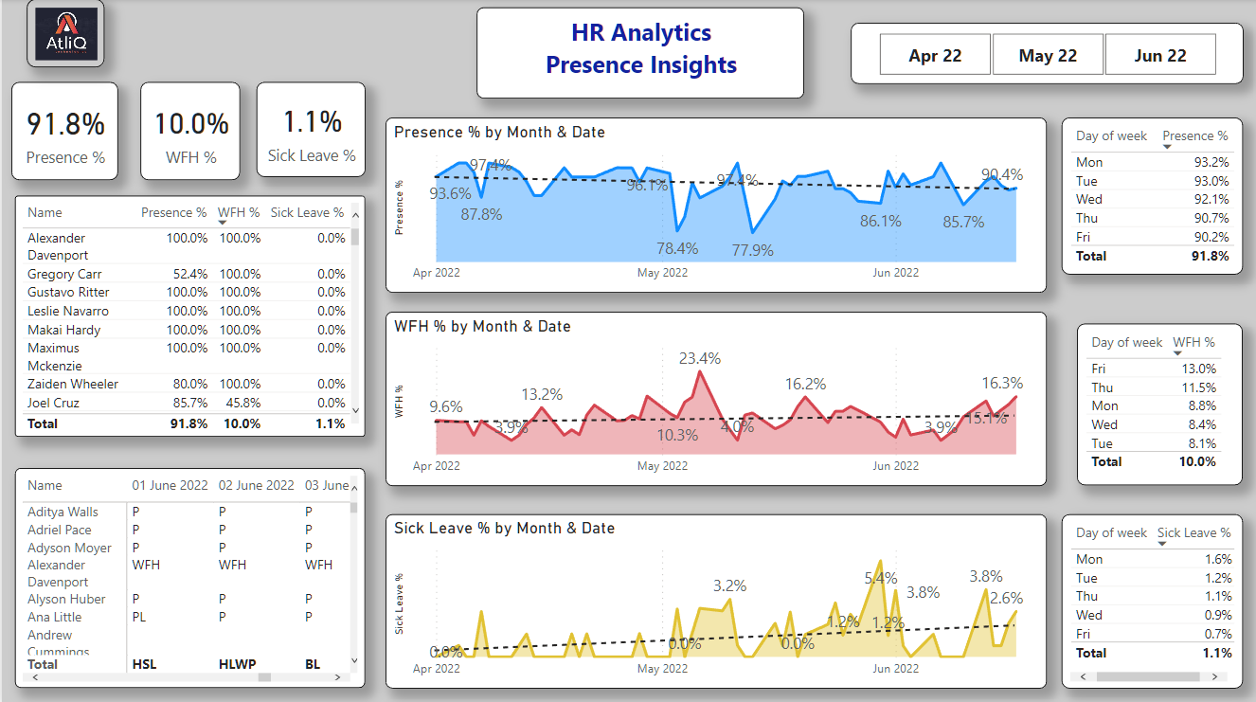
Data visualization

Slide 8
Data Visualization
Here is the data visualization of HR data which displays the KPI and tells about Employee Presence %, WFH % i.e Work From Home %, and Sick Leave %.
On the basis of last 3 months the Overall Percentage of Employee Presence is 91.8%, WFH % is at 10%, and Sick Leave % is 1.1%.
Below the KPI of the Dashboard we can see the Employee names with their respective Presence %, WFH % and Sick Leave %.
Below that table there is again the list of names with according to the Attendence Key Values.

Slide 9
Data Visualization
Apart from other Insights here the Dashboard also displays the data of Months from April 2022 to June 2022.
Below the month slicer we have the Area Chart which shows the Presence % by Month and Date which also include a Trend Line.
Below the first Area Chart we have another similar chart which shows Work From Home % and below that we have Sick Leave % chart by Month and Date along with Trend Line.
On the sides we have different classification according to the Week Days in every Month.

Slide 10
Treat employees like they make a difference and they will.
“
”
Jim Goodnight

Slide 11
AREAS OF FOCUS
Employee Presence
Employee Work from home
The Employee Presence Rate is Declining and Work From Hone % is Increasing along with the Sick Leave %
As an Head os Human Resource Management you must focus on what reasons these type of leaves are happening and find the reasons why they are getting sick leaves.
Get Proper response from the Employees about their problems and situations and find solutions to the same.
As Work from Home will increase in Future it’s Important to understand your own Employees.
By Communicating with employees find out why most of them want to Work from home and Half work from home.
Finding out the main reasons and solving their issues from working at the office if any.

Slide 12
SUMMARY
At AtliQ Technologies as you saw there is a major issue in last couple of months regarding the Employee Presence Data and so after analysing this Data the company will try to create new strategy so that it’s most of the works are done when there are high employee presence %.
Also this will also lead the Company to follow a Hybrid Model where they will be having less Office Rental Costs as the Office runs in alternate days.

Slide 13
THANK YOU
Gurunatha Hebbar​
My Github

